Slide 1
Linguistics 201
Morphology 1
Francisco Torreira

Slide 2
Logistics
Assignment 2 due this Wednesday
Midterm exam on Feb 22 after Morphology unit
Exam covers Phonetics and Phonology units only

Slide 3
Today
Morphology
Definition
Words and morphemes
The lexicon
Allomorphy
Types of words
Monomorphemic vs. multimorphemic
Types of morphemes
Free vs. bound
Roots vs. affixes

Slide 4
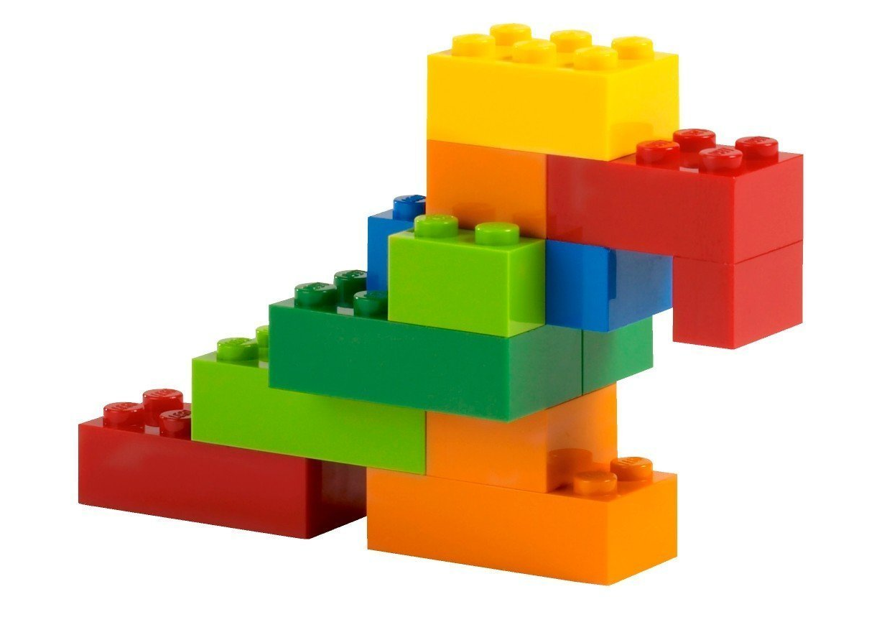
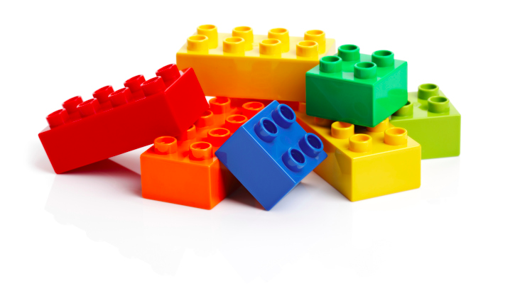
What is morphology?
The study of the structure of words
WORDS
The smallest free-standing units of language
MORPHEMES
The smallest unit that carries meaning or function

Slide 5
Morphemes and words
Morpheme: smallest unit in a language that carries meaning or function
Each word contains at least one morpheme:
cats 2 morphemes (cat + s)
stark 1 morpheme (stark)
unmissable 3 morphemes (un + miss + able)

Slide 6
Morphemes and words
Words are the smallest free forms found in language:
They do not have to occur in a fixed position with respect to neighboring elements
Typically, they can appear in isolation
Consider the following:
(1) Dinosaurs are extinct.
(2) Are dinosaurs extinct?
(3) * Dinosaur are s extinct. * = not grammatical
(4) What are you afraid of? Dinosaurs.
Dinosaurs is a word, as it can appear in different environments, and in isolation
The -s plural morpheme is not a word by itself, as it always occurs immediately after its base (e.g. after cat, dinosaur, boy).

Slide 7
What are morphemes in “crowdfunding?
multiple answers OK!
crowd
crowdfund
fund
-ing
crow
Don’t know
Answer: A, C, and D

Slide 8
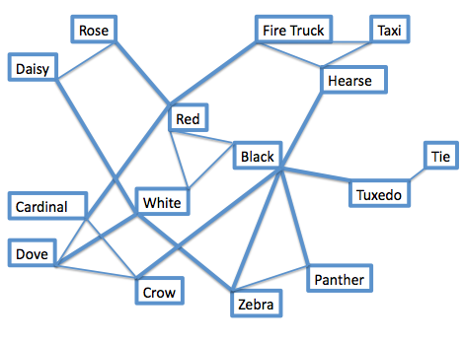
The lexicon
/ɹowz/
Noun
Type of shrub / flower…
Inventory/network of words and morphemes in a language. Each entry must be associated with three values:
Phonological form e.g. /kæt/
Morpho-syntactic category e.g. Noun
Meaning e.g. Feline animal
Varies by dialect, and:
A little different for every person
Age and education
25-60k words for native English-speaking adults
You can estimate how many words are in your mental lexicon here
/zibɹə/
Noun
Type of animal…
Notes:
Note here: knowledge is not necessarily conscious! For example, you probably know what “un-” means, but don’t know that you know this. MS: knows estimated 87% of words (=52.6k)

Slide 9
The lexicon
/ɹowz/
Noun
Type of shrub / flower…
Assumption 1: In the lexicon, each morpheme typically has one underlying phonological form only
e.g. /kæt/
Assumption 2: Phonological rules (aspiration, flapping, etc.) affect any morpheme when spoken in an utterance
Their surface forms in spoken language are determined by the phonological rules of the language
e.g. In word-final position: [kæt̚ ] , [kæt], or [kæt^{h}]
/zibɹə/
Noun
Type of animal…
Notes:
- How is this different? Allophonic processes would affect s in any morpheme. Allomorphy is morpheme-specific!

Slide 10
Morphology
Just like in phonology, we will assume that morphology is rule-governed and productive
Arbitrary sound-meaning pairing + rules = creativity
You can:
make new morphemes: google
plug them into the system and combine them with old ones: google-ing, google-able
combine existing ones in new ways and be understood: un-shush-able, un-tree-able
Notes:
example google
example un-shushabel

Slide 11
Morphemes and allomorphs
Certain morphemes can exhibit more than one surface form i.e. allomorphs depending on the phonological context* as the result of morpheme-specific phonological rules
Ex: The English plural morpheme -s /z/ has three allomorphs [z], [əz], and [s]:
cat /kæt + z/ [kæts] Devoicing after voiceless non-sibilant consonant
fox /fɑks + z/ [fɑksəz] Schwa-insertion after sibilants i.e. /s, z, ʒ, ʃ, tʃ, dʒ/
dog /dɑg+ z/ [dɑgz] [z] elsewhere (least restricted environment)
In this case, the rules that predict the correct allomorph do not apply to the phoneme /z/ across the English lexicon, but rather only to the plural morpheme /z/

Slide 12
Allomorphy
Other examples of allomorphy in English:
-ed (past tense marker)
walked [-t] after voiceless consonants other than /t/
hunted [-ɪd] or [-əd] after /t/ or /d/
obeyed [-d] elsewhere
a (indefinite article)
a person: [ej] when stressed
an orange: [ən] when unstressed before a vowel
a person: [ə] when unstressed elsewhere

Slide 13
Steps in constructing “cats”, “dogs”, “foxes”
Surface realization (i.e. pronunciation) comes about via 4 steps:
Lexical entries (underlying phonological level)
Morphological rules
Morphophonological rules applying to the /z/ plural morpheme
Allophonic (surface phonetic) variation

Slide 14
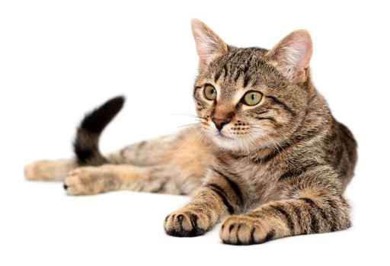
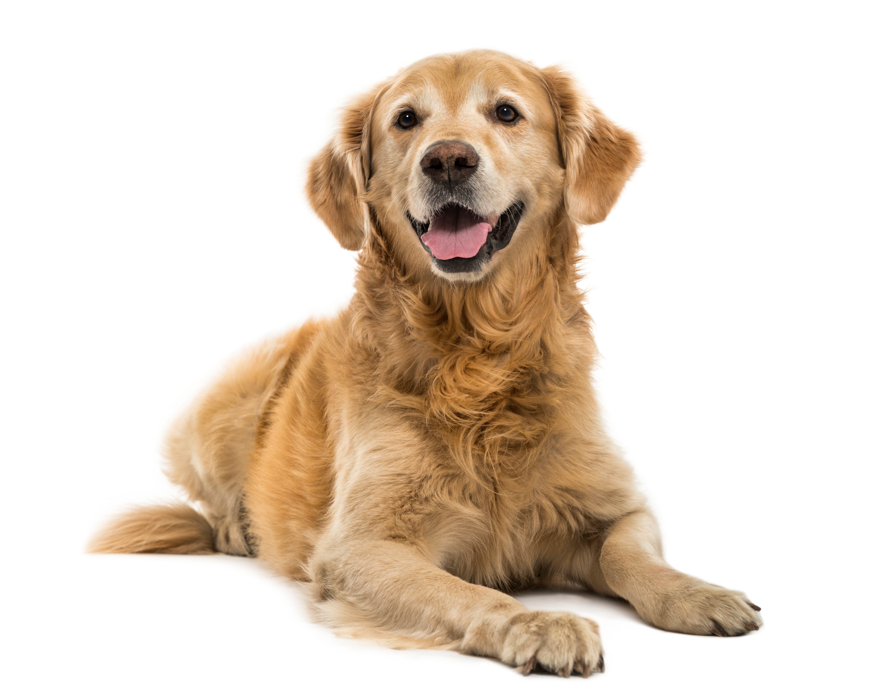
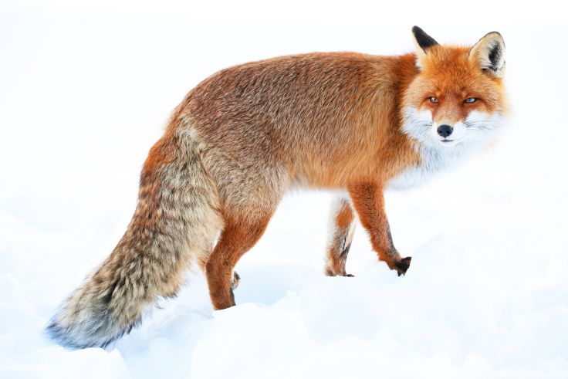
Steps in constructing “cats”, “dogs”, “foxes”
Lexical entries
/kæt/
Noun
/dɑg/
Noun
/fɑks/
Noun
/-z/
suffix
[plural]

Slide 15
Steps in constructing “cats”, “dogs”, “foxes”
2. Morphological rule (of plural formation):
Noun → Noun + /z/
Outputs:
/kæt-z/
/dɑg-z/
/fɑks-z/
3. Morphophonological rules (apply to specific morphemes only)
Outputs:
kæt-s
dɑg-z
fɑks-əz
1. Devoicing: /z/ -> [s] / voiceless non-sibilant _
2. Schwa-insertion: ø → [ə] / sibilant _ z
This means ‘nothing’, not a mid front rounded vowel!

Slide 16
Steps in constructing “cats”, “dogs”, “foxes”
4. Allophonic rules (apply to all morphemes/words)
Outputs:
[kʰæt̚s]
[dɑːgz]
[fɑksəz]
aspiration before stressed vowels OR in word-initial position
unreleased /t/ in /t/+obstruent word-final sequences
vowel lengthening before voiced obstruents
Notes:
On the other hand, stressed voiceless stops are aspirated across the board > allophony, not allomorphy

Slide 17
Steps in constructing plural nouns in English
Surface realization comes about via 4 steps:
Lexical entries e.g. /kæt/, /z/
Morphological rules /kæt/ + /z/
Morphophonological rules applying to the /z/ plural morpheme [kæts]
Allophonic (surface phonetic) variation [kʰæt̚s]

Slide 18
Types of words
Mono-morphemic
cannot be decomposed into more than one meaningful part
e.g. tree, black, think
Multi-morphemic:
Words that are morphologically complex
e.g. tree-s, black-board, un-think-able

Slide 19
Choose all the words that are morphologically complex
multiple answers OK!
street
walking
computer
clover
bring
walk + ing
compute + er
Notes:
Notice that ing is a morpheme in walking, but not in bring, and that er…

Slide 20
Types of morphemes
Free vs. bound morphemes:
Free: a morpheme that can stand as an independent word (i.e. can be free-standing)
e.g. tree, black, board, think
Bound: a morpheme that can’t stand alone
e.g. -s, -un, -able

Slide 21
Choose all the free morphemes
multiple answers OK!
over
inter
istic
thought

Slide 22
Bound vs. free morphemes
The frequency of free and bound morphemes varies a lot across languages:
Analytic languages have mostly free morphemes
e.g. Vietnamese:
khi tôi dên nhà ban tôi, chúng tôi bát dâu làm bài.
when I come house friend I PLURAL I begin do lesson
when I came to my friend's house, we began to do lessons.
Synthetic languages have mostly bound morphemes
e.g. Yup’ik Inuit:
tuntussuqatarniksaitengqiggtuq
tuntu -ssur -qatar -ni -ksaite -ngqiggte –uq
reindeer -hunt -FUT -say -NEG -again -3SG:IND
He had not yet said again that he was going to hunt reindeer.
Notes:
Polysynthetic languages can be agglutinative or fusional depending on whether they encode one or multiple grammatical categories per affix.

Slide 23
Cross-linguistic variation in morphological complexity
Polysynthetic
i.e. extremely synthetic
(Inuit)
Isolating
i.e. extremely analytical
Data from Greenberg (1959)

Slide 24
Roots and affixes
Root:
The morpheme in a word that carries the major component of meaning
Must belong to a lexical category (e.g. noun, verb, adjective, preposition)
e.g. reading read + ing
boys boy + s
unstoppable un + stop + able
nicest nice + est

Slide 25
Roots and affixes
In English, roots are typically free morphemes:
reads: read + s, where the root read is a free morpheme
toys: toy + s
Bound root (rare in English): carries meaning, has lexical category, but cannot stand on its own:
“-flate”
de-flate, in-flate
“ept”, “kempt”
in-ept, un-kempt
In English these are rare
But in many languages most roots are bound!

Slide 26
Bound roots
Bound root: carries meaning, has lexical category, but cannot stand on its own
In Japanese, verbs are always bound e.g. /toɾ/ ‘take’
/toɾ-anai/ “don’t take”
/toɾ-ɯ/ “take (present tense)”
/toɾ-e/ “take!”
In Spanish, verbs are always bound e.g. /kom/ ‘eat’
/kom-o/ “I eat”
/kom-es/ “you eat”
/kom-emos/ “we eat”

Slide 27
Roots and affixes
Affix: no lexical category*, always bound, e.g.
“un-” (not, contrary to)
un-necessary, un-wind
“-s” (plural)
“-able” (capable of, suitable for)
sing-able, win-able
* Note: In the lexicon, these can be listed without a lexical category, or simply as ‘Affix’
Notes:
note that there is also a free variant of ‘able’ that is has different first vowel

Slide 28
Types of affixes
Prefixes and suffixes are attached to the front and end of their bases, e.g.
Infixes are inserted within another morpheme, e.g. -in- infix in Tagalog

Slide 29
Summary
Morphology: Study of word structure
Morpheme: smallest meaningful unit in language cat, dog, -s, -ing
Words: smallest free-standing units in language cat, cats, dogs, walk, walking
Can be mono or polymorphemic
The lexicon: inventory of words and morphemes in a language
Morphemes can be free vs. bound
Free: can stand alone as words cat, walk
Bound: cannot stand alone e.g. /–s/ plural marker) -s, -ing
Morphemes are either roots or affixes
Roots: carry major meaning component; have lexical category walk, cat, dog
Affixes: no lexical category, always bound -ing, -s

